Slide 1

NLP NINJAS – Members
NLP
Ninjas
Max Waldron Scrum Master / Developer
Matt Talarico Product Owner / Developer
Scot Wilson Architect / Developer

Slide 2

NLP NINJAS – PROBLEM STATEMENT
Problem Context
Domain: Federal Government, US DoT, FAA
Importance: Automating the categorization of occurrence data saves time and provides a comprehensive framework that can be used to monitor safety trends impacting critical infrastructure
Problem Statement
Aircraft manufacturers, airline operators, and mechanics are required to submit service difficulty reports (SDRs) to the FAA according to 14 CFR §121.703 and 135.415
An ideal SDR includes an accurate JASC code classification across various submitters
More than 50,000 SDRs are submitted each year
One of the most valuable fields often lies in the narration – or description – of an observed malfunction, failure, or defect
Incorporating an automated system that accurately and efficiently classifies occurrences improves resource allocation, develops superior oversight, and enhanced risk mitigation
IMAGE LINK: https://www.google.com/url?sa=i&url=https%3A%2F%2Fdronelife.com%2F2019%2F07%2F05%2Ffaa-restricts-drone-operations-over-additional-military-facilities-faa-news-release%2F&psig=AOvVaw2Pmo874OCXKX1HcqHSEEyN&ust=1622028435277000&source=images&cd=vfe&ved=0CAIQjRxqFwoTCKiP5NDd5PACFQAAAAAdAAAAABAD

Slide 3
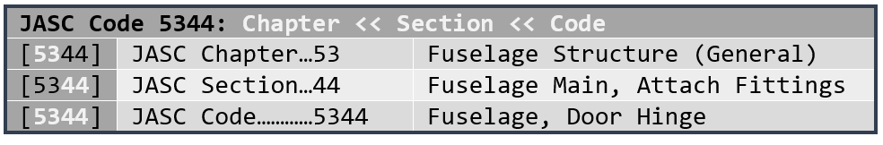
NLP NINJAS – Problem Statement details
Pulled Data from FAA report database
Dataset pulled contains 76 fields that contribute to assigning a JASC code (Joint Aircraft System/Component Code)
JASC code is the output variable we look to predict based on these other fields.
JASC codes have 4 digits (ex. 1234)
The JASC codes are organized in a hierarchical structure and can be broken down into nested, parent<<child-like levels.
Containing a 2-digit chapter code followed by another two, single digits section codes.
JASCCode | NatureOfConditionA | AircraftMake | AircraftModel | AircraftSerialNumber | AircraftTotalTime | AircraftTotalCycles | PartMake | PartName | PartNumber | PartSerialNumber | PartCondition | PartLocation
2750 | J | EMB | EMB145EP | 145169 | 28589 | 21458 |  | FLAP SYSTEM |  |  | FROZEN
2740 | J | EMB | EMB505 | 50500039 | 738 | 497 |  | ACTUATOR | 4675001003 |  | FAILED | PITCH TRIM
3230 | J | HWKSLY | HS125600B |  | 10301 |  |  | LANDING GEAR |  |  | MALFUNCTIONED
5340 | O | DHAV | DHC8202 | 512 | 33921 | 46133 | BOMBDR | ATTACH FITTING | 0 | 0 | CORRODED | BS 201-222
3260 | N | SAAB | 340B | 340B413 | 33570 | 37120 |  | WARNING LIGHT |  |  | FALSE ACTIVATION | MLG
5720 | W | CNDAIR | CL604 |  |  |  |  | DRAIN LINE | PN60062020201 |  | MISROUTED | AILERON
2430 | H | DIAMON | DA20C1 |  | 5989 |  |  | BOLT | 2224150001 |  | BROKEN | ALTERNATOR PIVOT
2910 | K | AIRBUS | A320211 |  | 71980 |  |  | HOSE | AE2463921G0181 |  | LEAKING | HYD SYSTEM
6111 | O | BOMBDR | DHC8400 |  | 11429 |  |  | BLADE | 697071003 |  | CRACKED | PROPELLER

Slide 4
NLP NINJAS – Project design
EDA
Word Clouds
Vocabulary Volume & Variety
Class Imbalance
Correlating Extractions
Polarity, Word Counts, Lengths, etc
Cleansing / Processing
Abbreviation & Acronym Substitution
Extracting Manual References & First Two Digits
Remove Numbers (too granular, dates, etc.)
Remove Punctuation, Stopwords
Lemmatize
Model Prep
Tokenize, N-Grams
Count Vectorizer
Feature Selection
TF-IDF Vectorizer
Group Infrequent Classes
text
all text
othertext
Model Selection
tune1
tune2

Slide 5
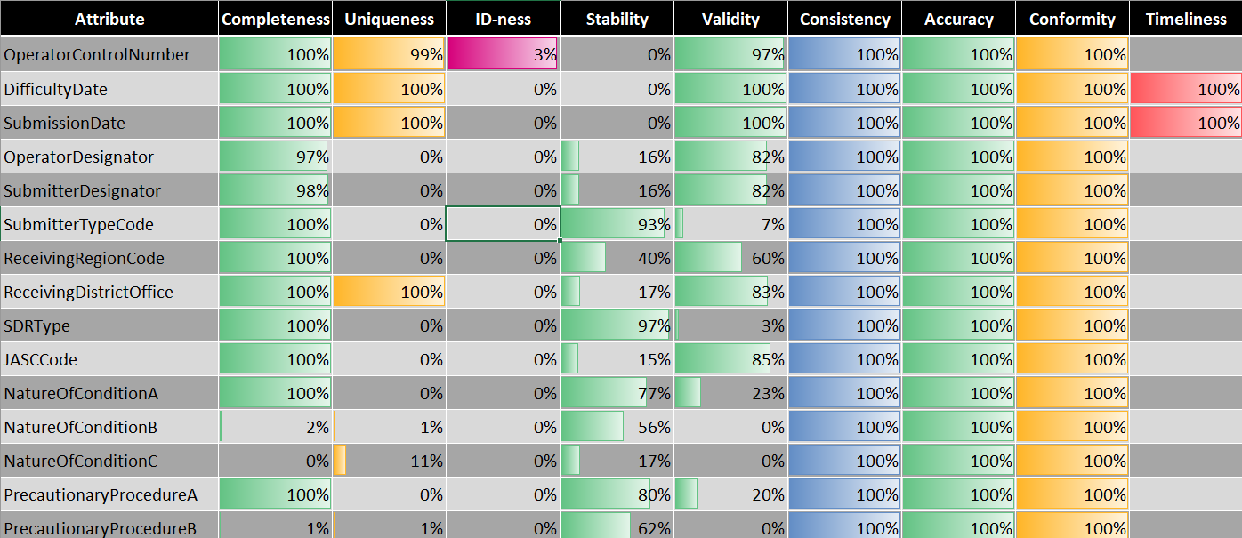
NLP NINJAS – Data Quality ASSESSMENT
Assessment Attribute | Scale | Description
Completeness | 0 - 100% | Requires that a particular column, element, or class of data is populated and does not feature null values or values in place of nulls (e.g., N/A). Completeness is an indication of comprehensiveness, measured as a percentage where 100% complete indicates all necessary records are present. When critical data is missing, the percentage of completeness is reduced.
Consistency | 0 - 100% | Something that tests weather one fact is consistent with another. A measure representing a percentage of data that reflect the same information as intended. Inconsistent data includes attributes or data not expected for intended information.
Uniqueness | 0 - 100% | Are all the entities or attributes within a dataset unique? A measure of duplicate values of items within a data set. Uniqueness = distinct values divided by count of values.
Stability | 0 - 100% | Count of most frequent non-missing value divided by total number of rows.
Integrity | 0 - 100% | Are all the relationships populated for a particular entity? [e.g., the inability to link related records together may introduce duplication across systems]
Conformity | 0 - 100% | Does the data conform to right conventions and standards?
Validity | 0 - 100% | Fraction of values which are not counted as missing, infinite, ID, or stable.
Accuracy | 0 - 100% | Refers to whether the data values stored for an object are the correct values. To be correct, a data values must be the right value and must be represented in a consistent and unambiguous form. For example, my birth date is December 13, 1941.
ID-ness | 0 - 100% | Fraction of values which are ID-like.
Timeliness | 0 - 100% | Degree to which the data is up-to-date and available within acceptable time frame, timeline and duration.

Slide 6
NLP NINJAS – Data Quality ASSESSMENT
Initial criteria for exploring variable importance:
>95% completeness (near complete, required-like)
<10% uniqueness (not too unique – potentially related to distinctly identifiable group/class)
With either
>70% stability (limited # of groups/classes and does not deviate too often), or
>70% validity (fraction of values not counted as missing, infinite, ID, or stable)
Fields Meeting Criteria
OperatorDesignator
SubmitterDesignator
SubmitterTypeCode
SDRType
JASCCode
NatureOfConditionA
PrecautionaryProcedureA
StageOfOperationCode
RegistryNNumber
AircraftModel
AircraftSerialNumber
PartName
PartCondition
PartLocation

Slide 7
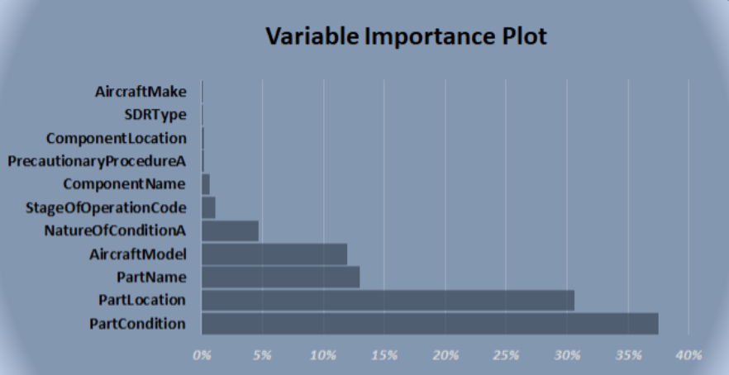
NLP NINJAS – Data exploration
Among the 76 fields in the SDR report, 11 fields were used to predict the JASC code based off their importance.
Of the 11, the fields containing “part” information gave the most insight into assigning a JASC code.

Slide 8
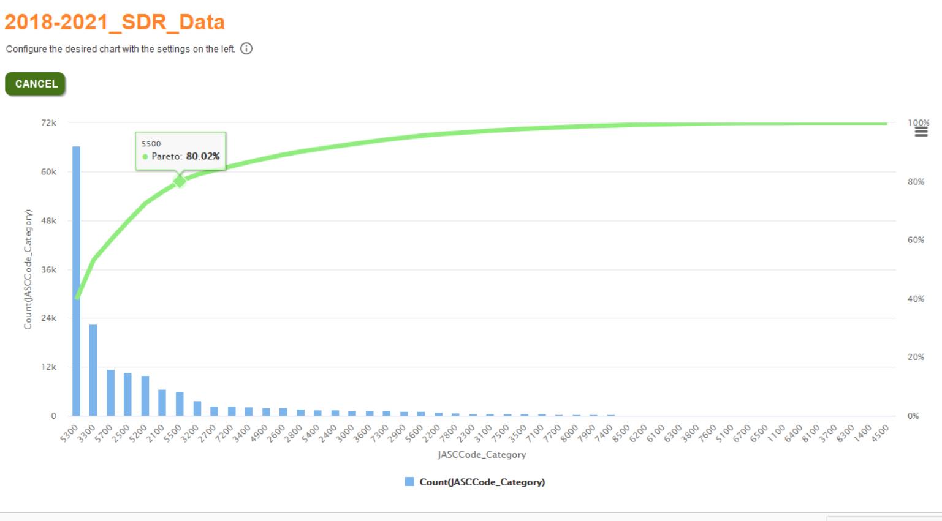
NLP NINJAS – CLASS IMBALANCE
The 51 JASC Code Chapter occurrences exhibit significant imbalance
The seven most common JASC Code Chapters account for roughly ≈ 80% of all SDRs
{5300 – Fuselage, 3300 – Lights, 5700 – Wings, 2500 – Equipment/Furnishing, 5200 – Doors, 2100 – Air Conditioning, 5500 - Stabilizers}
37 least used JASC Code Chapters represent ≈ 10% of all SDRs
Three of these 37 have zero occurrences in our dataset {1200 – Servicing, 1800 – Helicopter Vibration, 8200 – Water Injection}

Slide 9
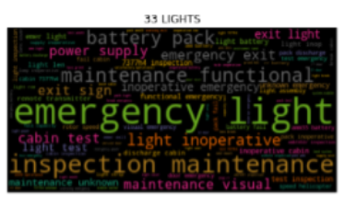
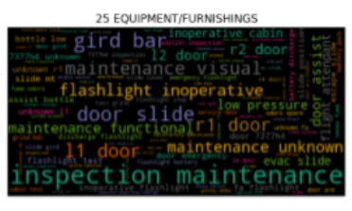
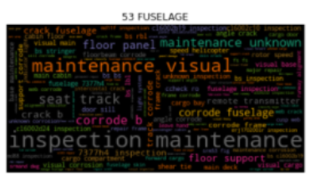
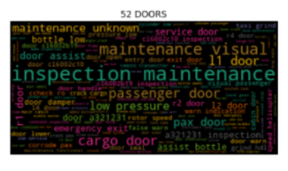
NLP NINJAS – Word clouds
JASC Chapter 33 - LIGHTS
JASC Chapter 25 – EQUIPMENT / FURNISHINGS
JASC Chapter 53 – FUSELAGE
JASC Chapter 52 – DOORS

Slide 10
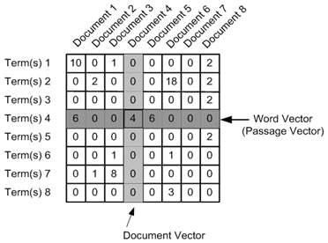
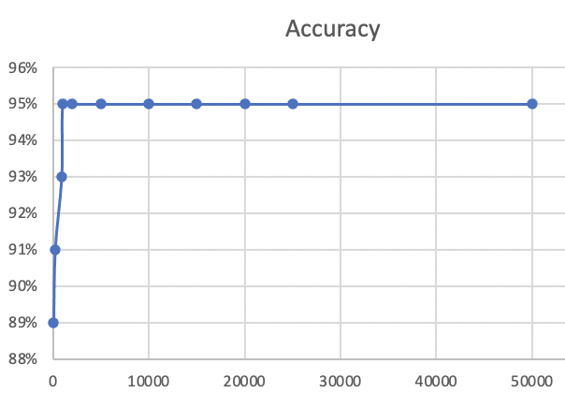
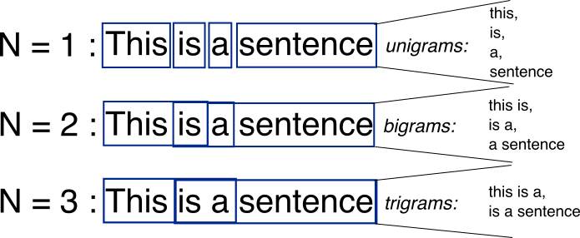
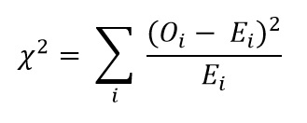
Feature engineering and selection
Vectorizer
Count
TF-IDF
Vocabulary
Size
ngrams
Results (Top 10 Chapters)
Independent of vectorizer
Dependent on size of vocabulary
>1K terms accuracy remains at 95%
Independent of N-grams
Independent of feature selection at the 99% threshold
Selection
Variance Threshold
Chi-Square

Slide 11
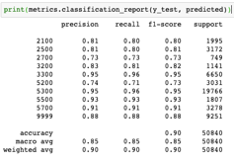
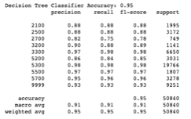
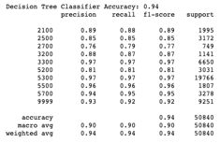
Model selection
Requirements
Explainability
Able to run with few resource
2-digit and 4-digit results
Accuracy
Models
Key Words (Decision Tree and Random Forest)
Space (SVM and KNN)
Gradient (XGBoost)
Neural networks (LSTM and BERT)
Fields
Text 90%
Other Text 95%
All Text 94%
TEXT
OTHER TEXT
ALL TEXT

Slide 12
NLP NINJAS – MODELING
Top 50 Codes Times and Accuracy
Model | Fields | Time (Min:Sec) | Accuracy
Decision Tree | Text | 4:33 | 80%
Decision Tree | Other | 2:16 | 90%
Decision Tree | All | 5:19 | 87%
Support Vector Machine | Text | 1:33 | 86%
Support Vector Machine | Other | 0:47 | 91%
Support Vector Machine | All | 1:59 | 90%
XGBoost | Text | 12:26 | 85%
XGBoost | Other | 14:16 | 91%
XGBoost | All | 15:18 | 91%

Slide 13
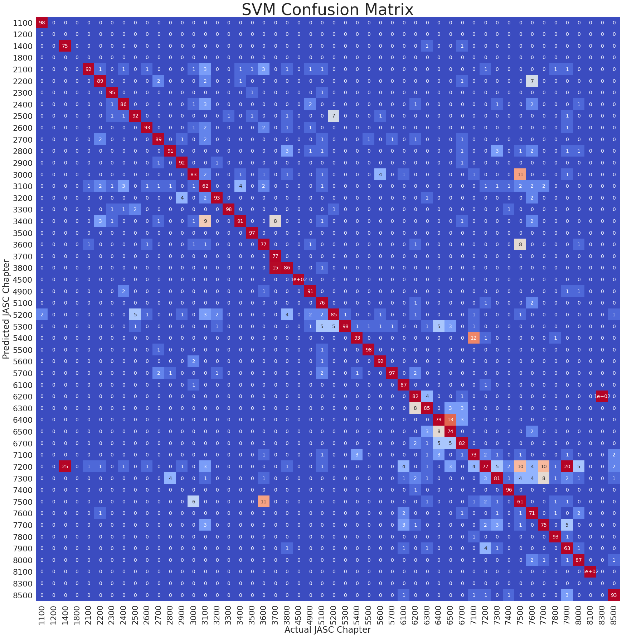
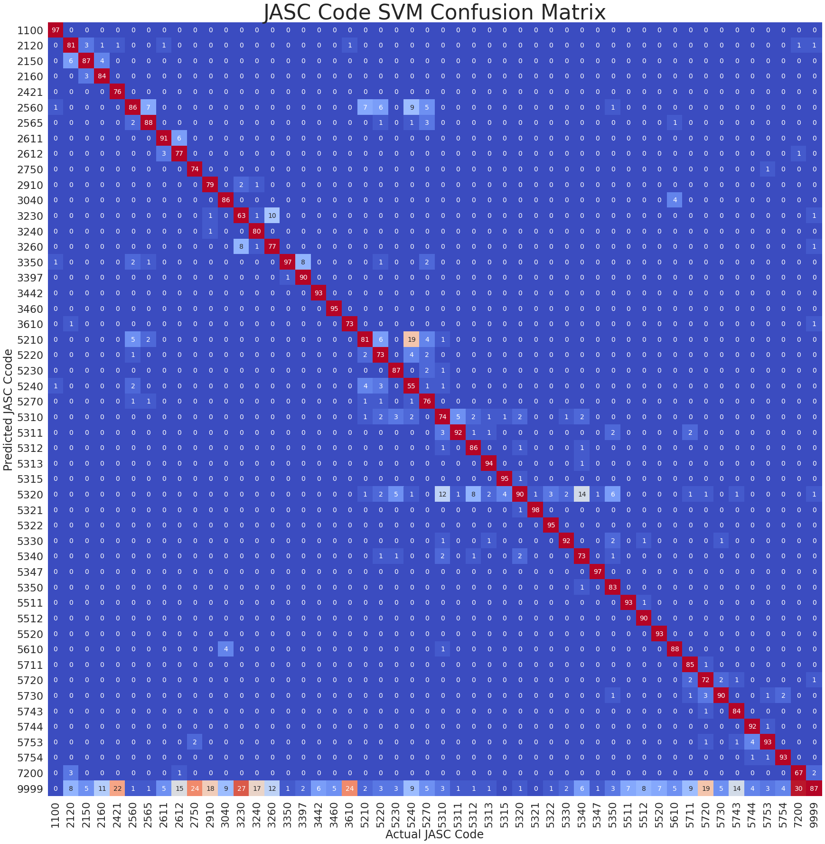
NLP NINJAS – Support Vector Machine (SVM) CONFUSION MATRIx
SVM model using text field to predict JASC chapter and code

Slide 14
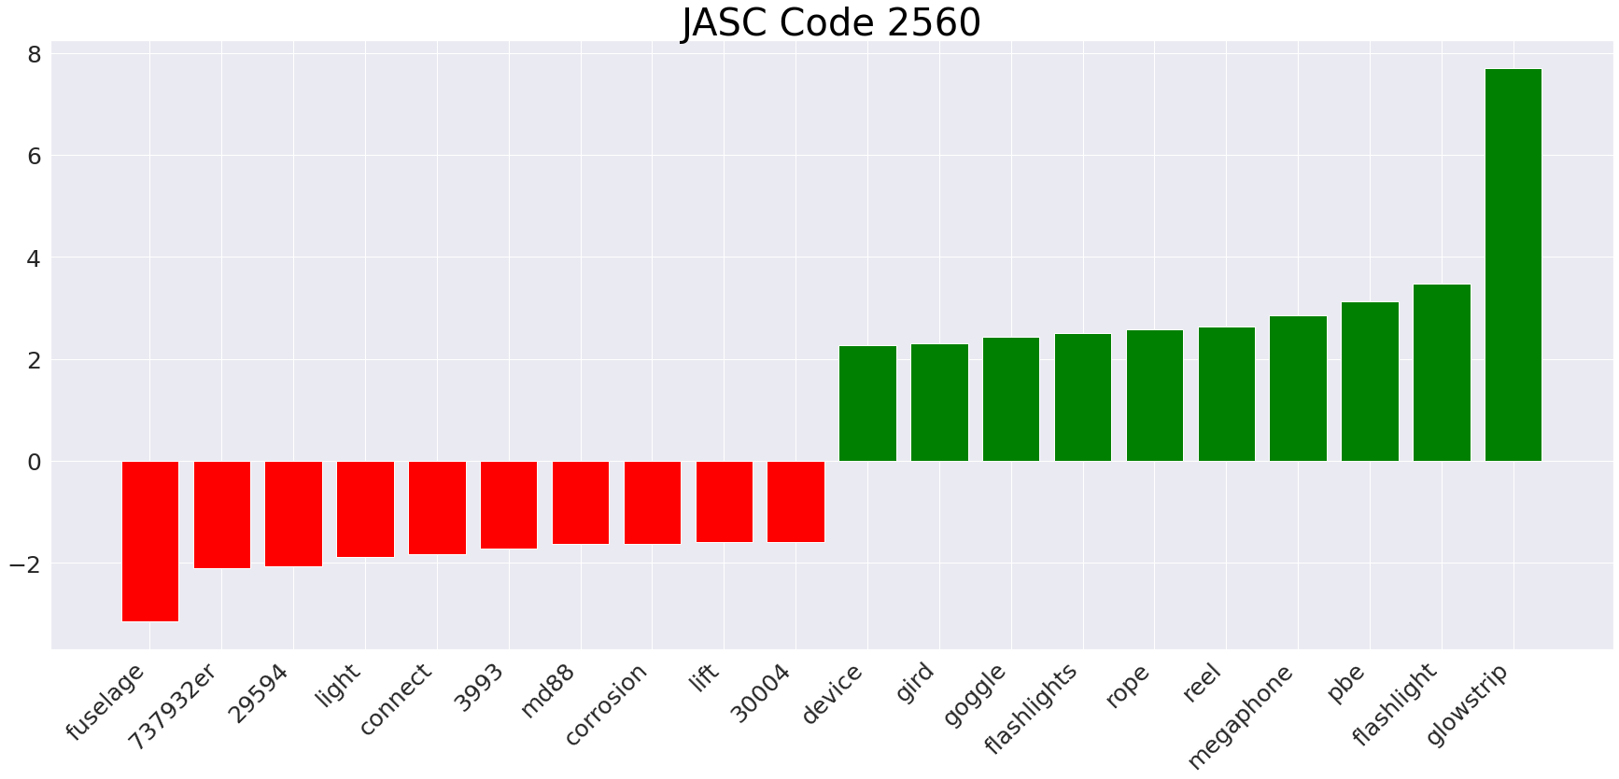
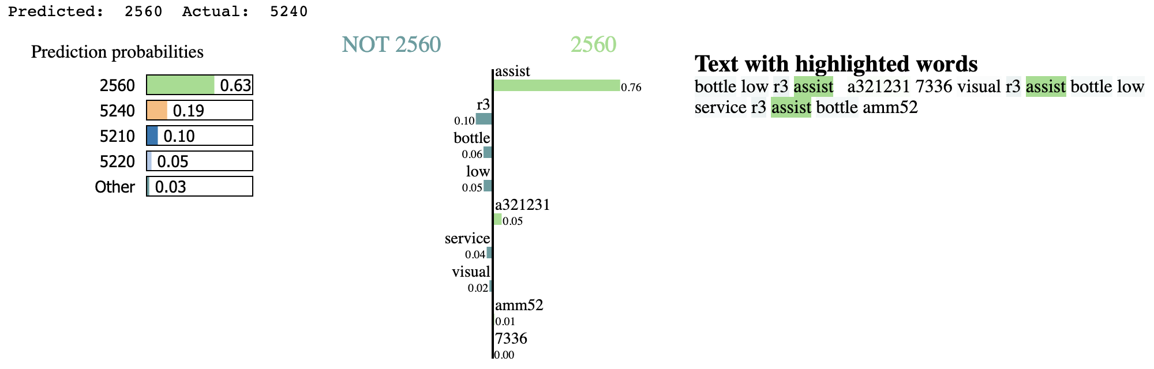
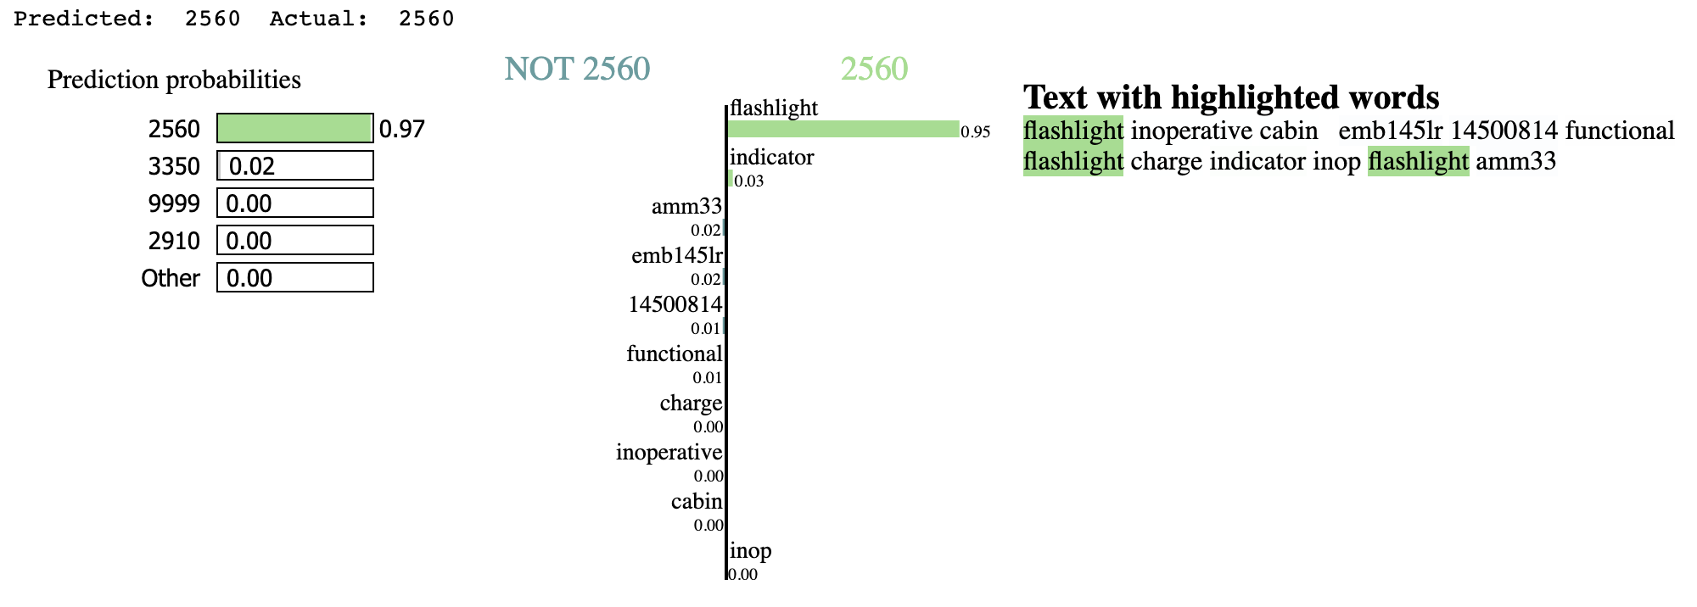
Model objectives and tuning

Slide 15
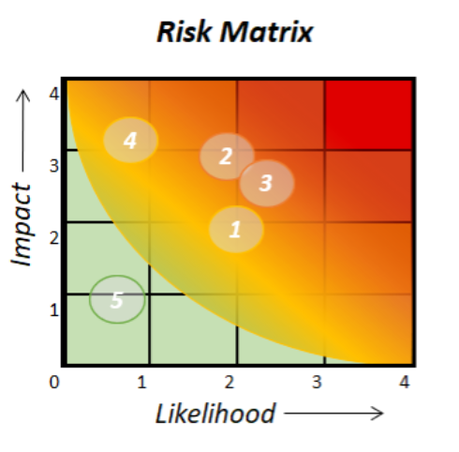
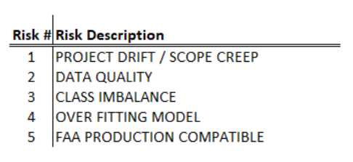
NLP NINJAS – Risks and Planned Mitigations

Slide 16
NLP Ninjas - SUmmary
Machine learning/modeling can improve the JASC code assigning process tremendously.
Discrepancy field did not provide the value initially believed.
Accuracy climbed once part related fields were used as the input variables.
Machine patterns are picked up from fields that may be overlooked by human eyes.

Slide 17
FINDINGS & Future Work
Future thoughts:
SVM model predicting JASC Chapters produces a 93% accuracy rate.
Inherent error rate
Subjectivity
Fields that contain the most importance
Current number of chapters could likely be trimmed down
Creating second level prediction model for too similar of chapters
Possible report amendments:
Questions on report driven by code/chapter descriptions/definitions
Application where reporter chooses from drop down questions that drill down into correct code chapters
Potential additional fields with a finite number of options to select from
AMM, FIM, MEL, etc.
Data quality, Missing data points
Produce a way to attach reports relating to same reoccurring critical issues

